Slide 1

Lendify 3D
Adam jankanič,matej pekán,ivan gajdoš

Slide 2

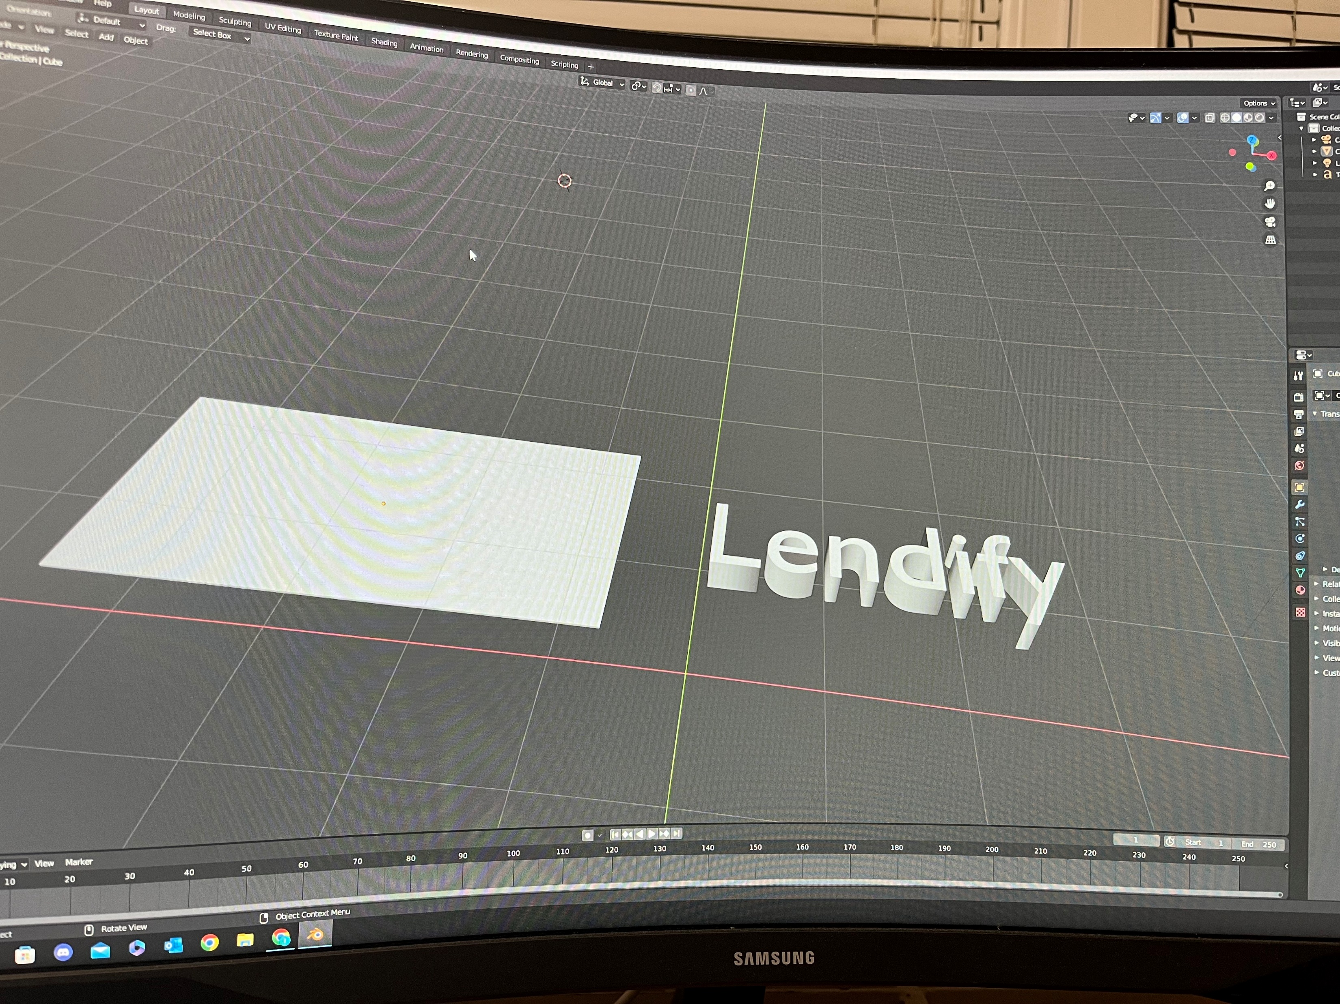
3d Modeling with blender

Slide 3

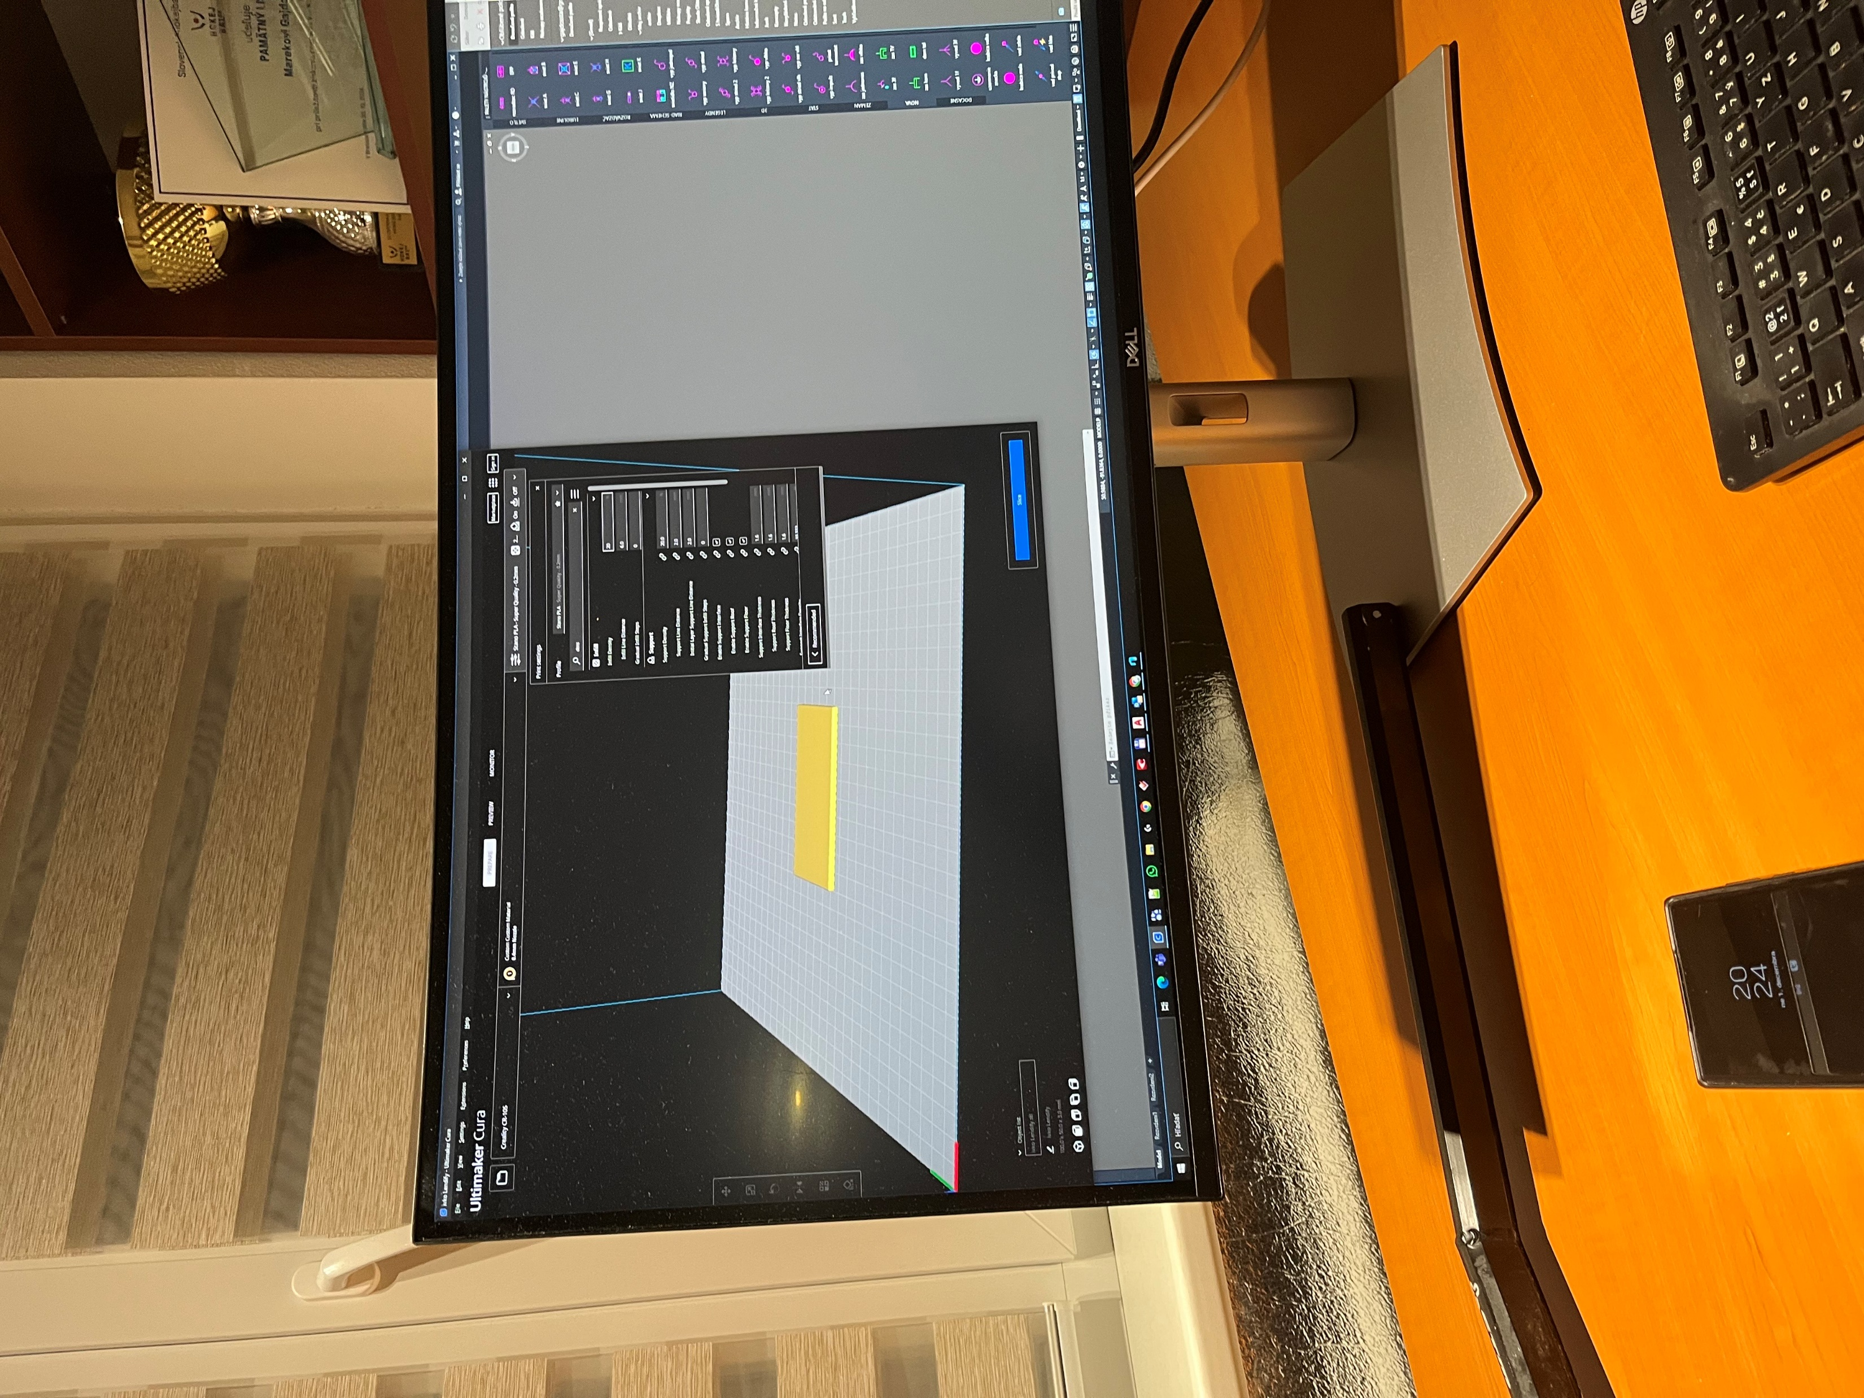
CURA – program for 3d printer

Slide 4
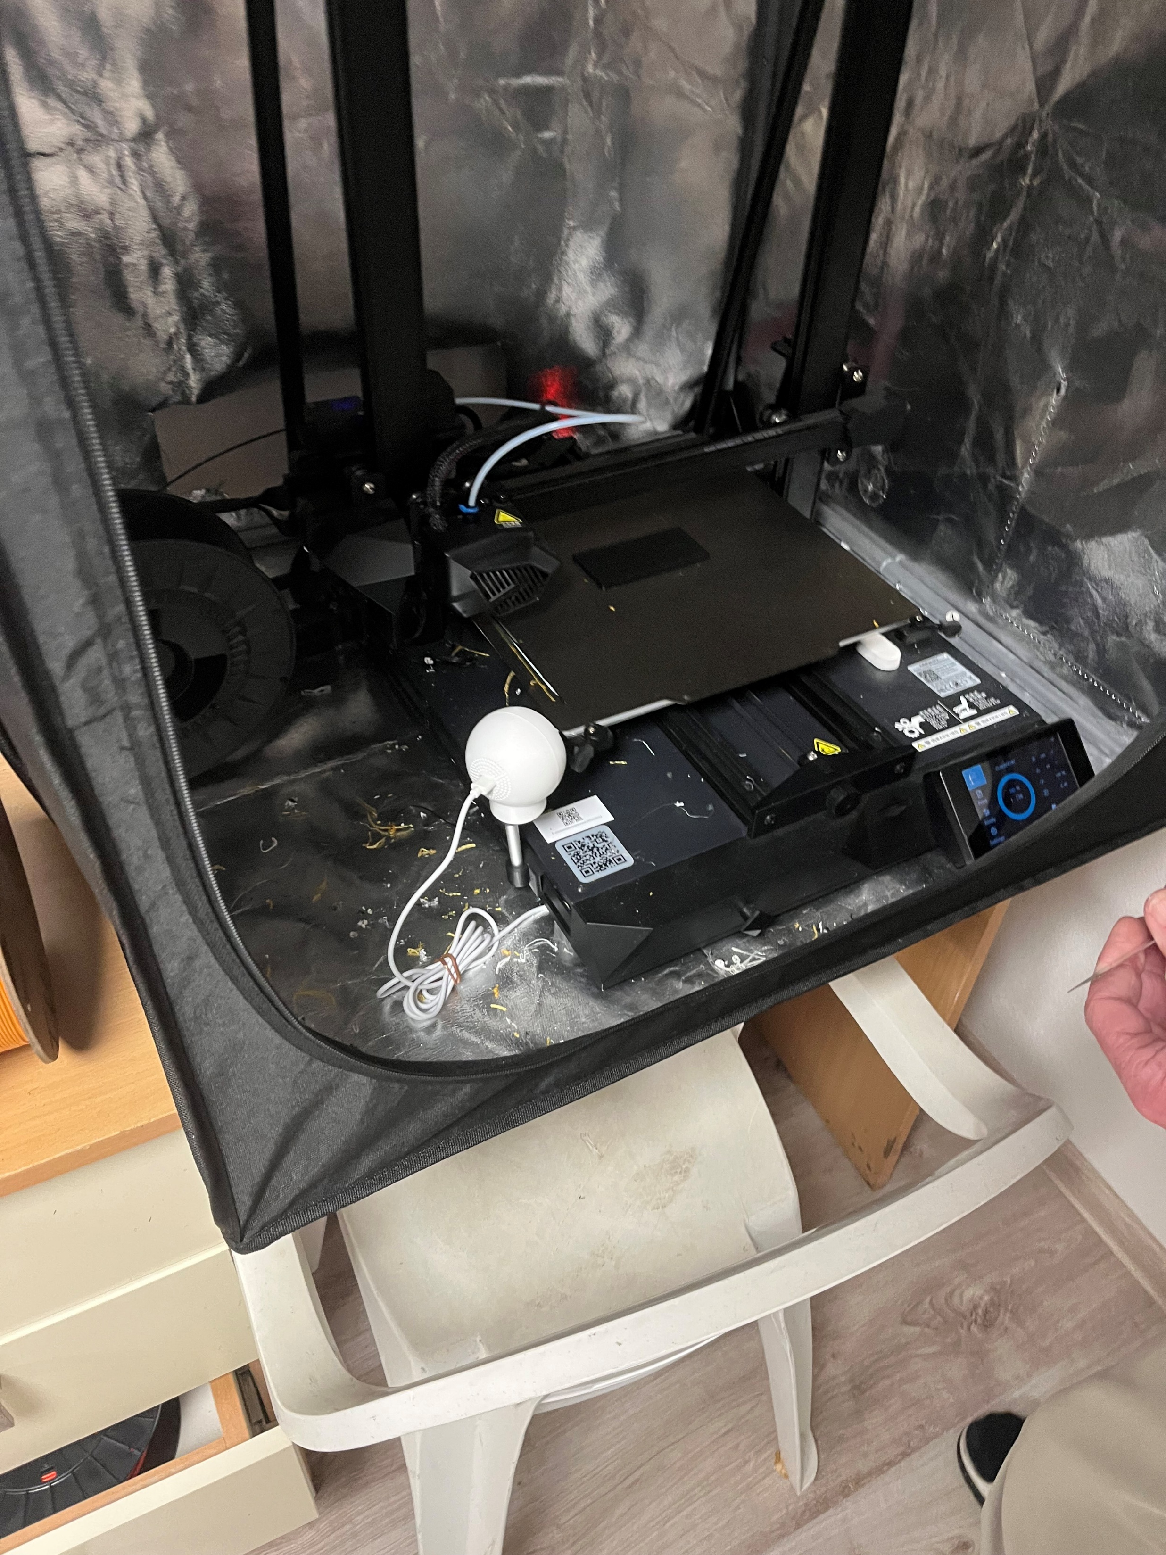
3d Printing
3D Printer Creality
PLA Material
Material Temperature 200°
Bed Temperature 60°

Slide 5
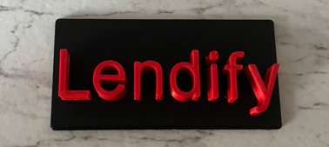
Final Product

